Slide 1
Graph database workshop
Graph database scenarios with Azure Cosmos DB Gremlin API

Slide 2
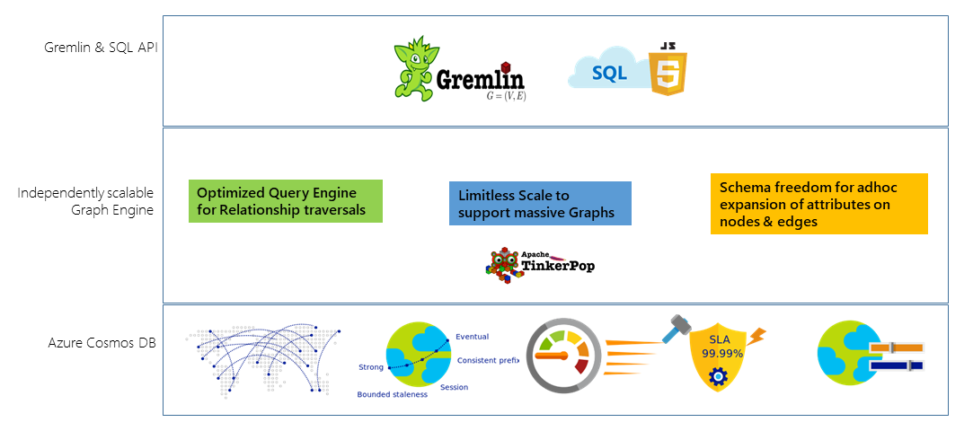
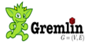
Graph database scenarios
Applications that require to connect multiple data points, while still keeping them as independent records would benefit from a graph database approach.

Slide 3

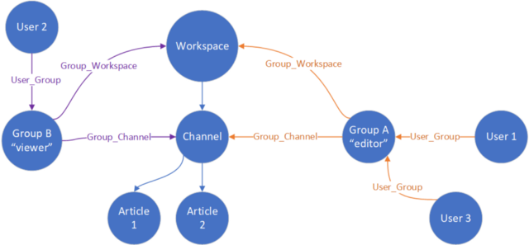
Role based access control
Permissions are based on group and role mapping.
Groups and roles membership can change at any time.
It used to be handled as a module in the front-end application.
https://medium.com/jettech/role-based-access-control-using-a-graph-database-2573debb685e

Slide 4

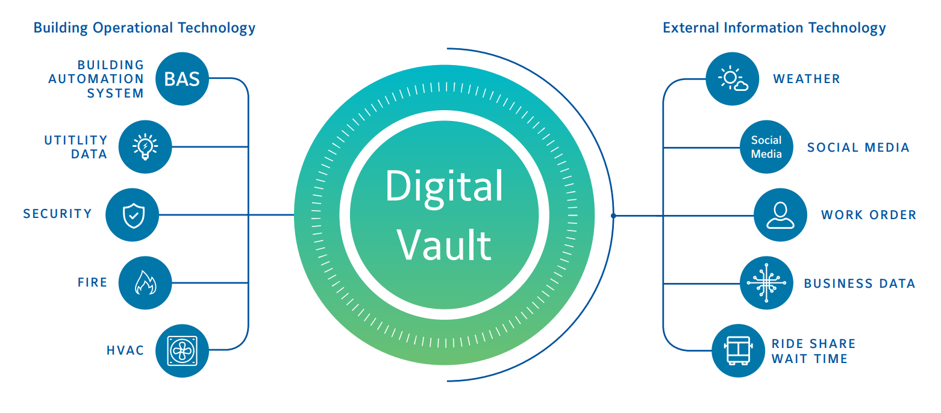
Digital Vault
Integrates data from multiple different sources.
Sources constantly update relationships and properties in entities.
Uses graph model flexibility to incorporate more sources in the future.
https://youtu.be/z4AqAxlLwDQ?t=1575
https://gotcosmos.com/about/customers#johnson

Slide 5

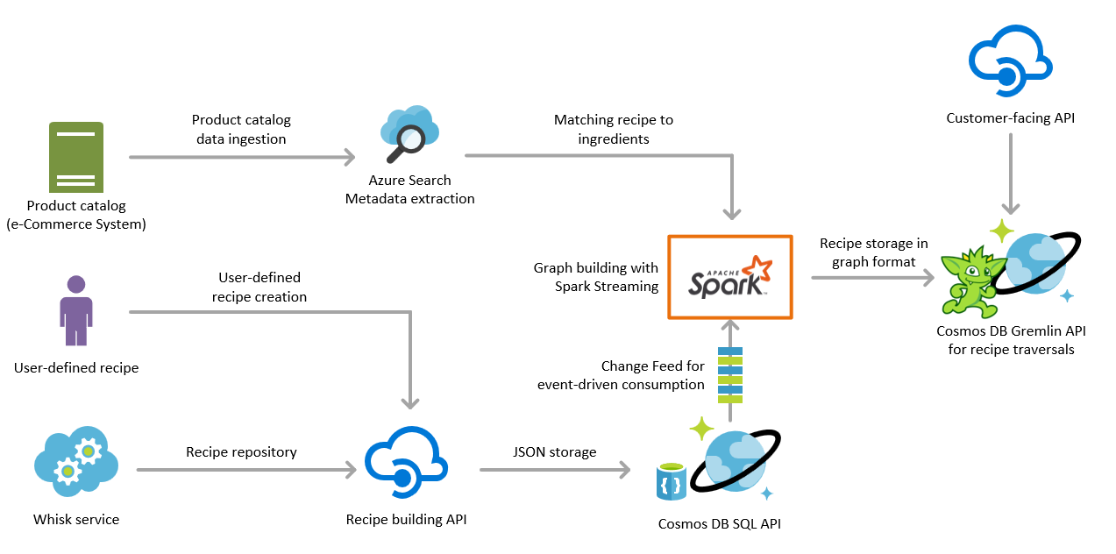
Recipe and catalog graph
Creates a graph view that matches recipes to catalog items per store.
Calculates recipe composition and ingredients at runtime.
Uses graph model to create a hierarchy of ingredients to recipes.
https://gotcosmos.com/about/customers#albertsons-safeway

Slide 6
BMW North America Production
Advantages:
Data model flexibility for future business needs.
Fast adjacency resolution queries.
Document access for paginated queries.

Slide 7
What do all of these scenarios have in common?
Industry vertical
Scale of data size
Ingestion architecture
Integrated multiple data sources

Slide 8
What do all of these scenarios have in common?
Industry vertical
Scale of data size
Ingestion architecture
Integrated multiple data sources

Slide 9
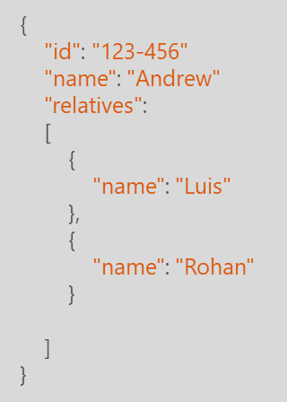
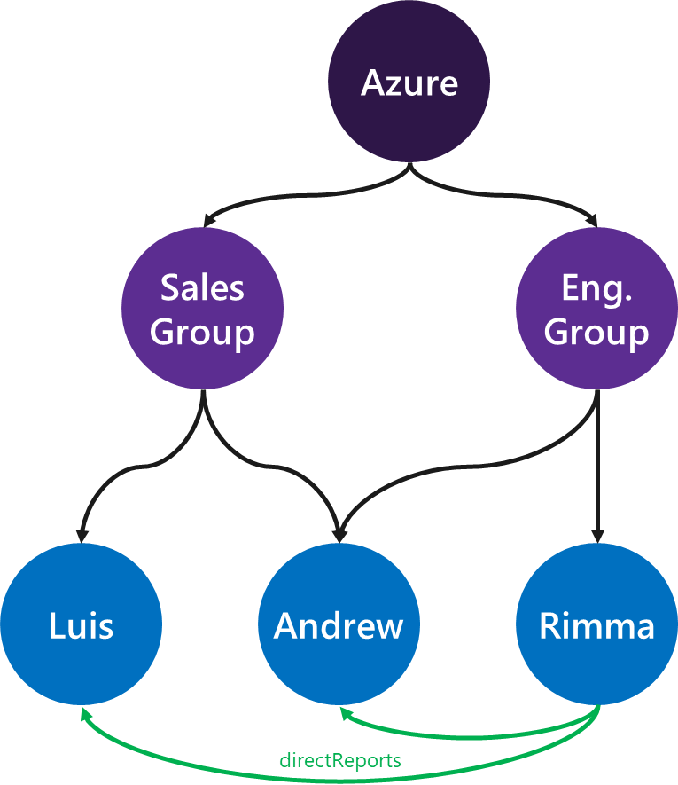
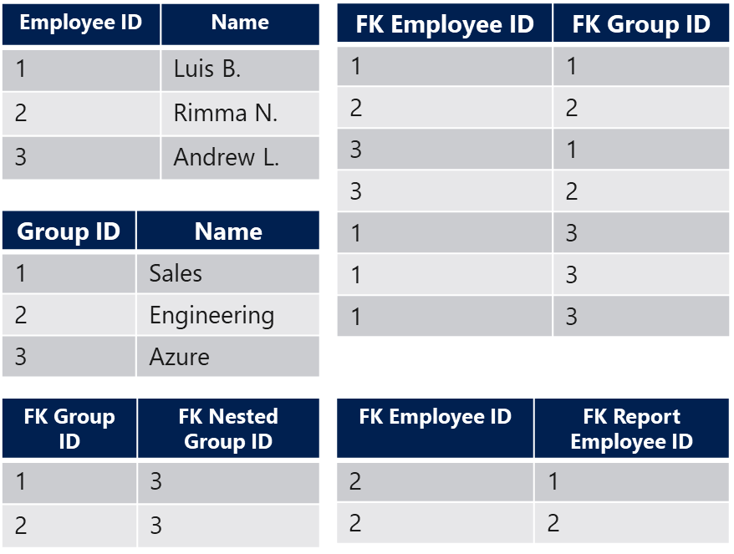
What do all these cases have in common?
Need to have a flexible data model for future integrations.
Dynamic resolution of relationships.
Integration of multiple data sources.
The logic to consume the data is embedded in the database.
Relational
Document
Graph

Slide 10

Application patterns for graph
Do you have an application with the following pattern?
It needs to integrate data from different sources.
It delegates the task to connect data to the client application.
It has data with changing relationships and connections.
N
1
Other app logic
Data resolution
Client
Middleware

Slide 11
Graph database modeling for efficiency
Graph-formatted data benefits from flexible problem-space modeling. However, some models can be more performant than others. In this section we will review how to create graph data designs that are optimized for the Cosmos DB database engine.

Slide 12
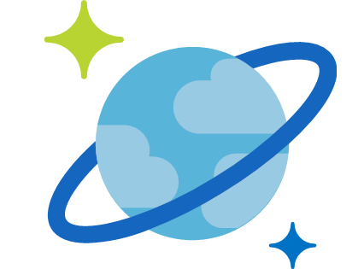
Gremlin API Scenarios
Cosmos DB Gremlin API is best suited for scenarios that make transactional graph operations and traversals, and naturally adapts to analytical scenarios through the native Apache Spark connectors.
Apache Spark
Graph OLTP
queries
Gremlin API
Graph-formatted
documents
Graph OLAP
queries

Slide 13
OLTP or OLAP Graph?
Scenario | Example | Solution
Adjacency resolution | Get me all nodes connected to this one. | Gremlin API
Point-based read and writes | Update these nodes, vertices, edges with this new value. | Gremlin API
Filtered predicates | Get me all connected nodes with a certain property. | Gremlin API
Linear aggregates | Get a count of all vertices with this criteria. | Gremlin API
Materialized traversals | Walk the graph and obtain these values from each hop. | Gremlin API
Large complex aggregates | Get me a sum of all properties of all edges connected to these vertices by a certain number of levels. | Gremlin API + Spark
Complex graph computation | Degree of centrality, large breadth first search, large shortest path computation, large cycle detection. | Gremlin API + Spark

Slide 14
Data Modeling Exercise
Comparing a graph data model with a relational model.

Slide 15
Chapter 1: The Green-field app

Slide 16
Human Resources Data Relational vs Graph oriented model comparison
Sales
Group
Eng.
Group
Employee ID | Name | Group
1 | Luis Bosquez | Sales
2 | Rimma Nehme | Engineering
3 | Andrew Liu | Sales
member
member
Luis
Andrew
Rimma
3 rows, 3 columns
8 documents (vertices and edges)

Slide 17
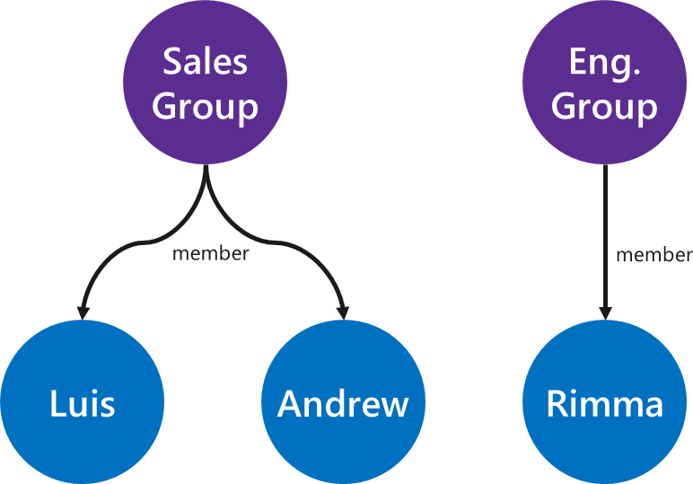
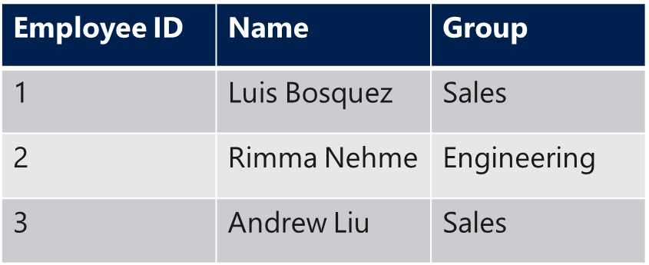
Human Resources Data Query comparison: get all employees.
SELECT * FROM v1_Employees;
g.V().hasLabel('employee')

Slide 18
Chapter 2: The hidden business requirement

Slide 19
REORG TIME Employees can now belong to multiple groups
Employee ID | Name
1 | Luis B.
2 | Rimma N.
3 | Andrew L.
Sales
Group
Eng.
Group
FK Employee ID | FK Group ID
1 | 1
2 | 2
3 | 1
3 | 2
member
member
member
Group ID | Name
1 | Sales
2 | Engineering
Luis
Andrew
Rimma
+ 2 tables, 6 rows, 4 new columns, -1 column alteration
+ 1 document

Slide 20
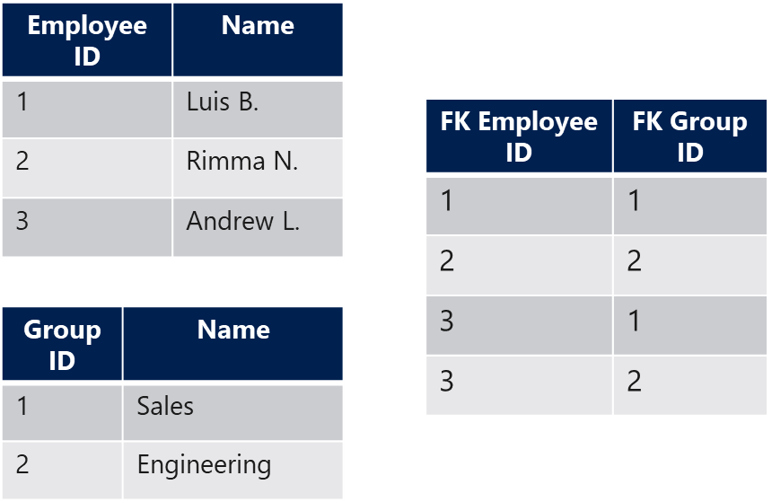
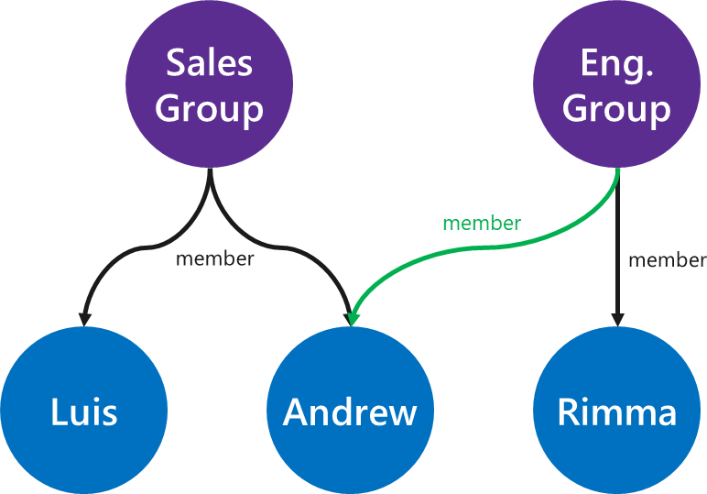
REORG TIME Query comparison: get employees from the Sales group.
SELECT * FROM v2_Employees
INNER JOIN v2_Employee_Group eg
ON Employee_ID = FK_Employee_ID
INNER JOIN v2_Groups g
ON FK_Group_ID = Group_ID
WHERE g.Group_Name = 'Sales'
g.V('sales')
.out('member')

Slide 21
Chapter 3: The unexpected data migration

Slide 22

Nested groups Employees are now part of multi-level groups
Azure
Employee ID | Name
1 | Luis B.
2 | Rimma N.
3 | Andrew L.
subgroups
FK Employee ID | FK Group ID
1 | 1
2 | 2
3 | 1
3 | 2
1 | 3
1 | 3
1 | 3
Sales
Group
Eng.
Group
Group ID | Name
1 | Sales
2 | Engineering
3 | Azure
FK Group ID | FK Nested Group ID
1 | 3
2 | 3
Luis
Andrew
Rimma
+ 1 tables, 6 rows, 2 new columns
+ 3 documents

Slide 23
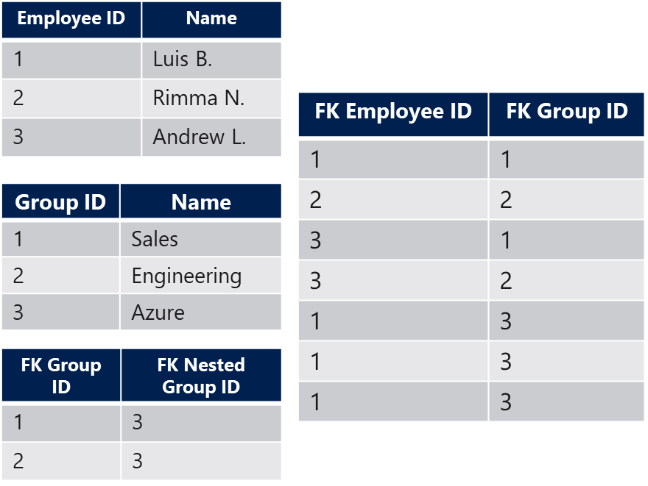
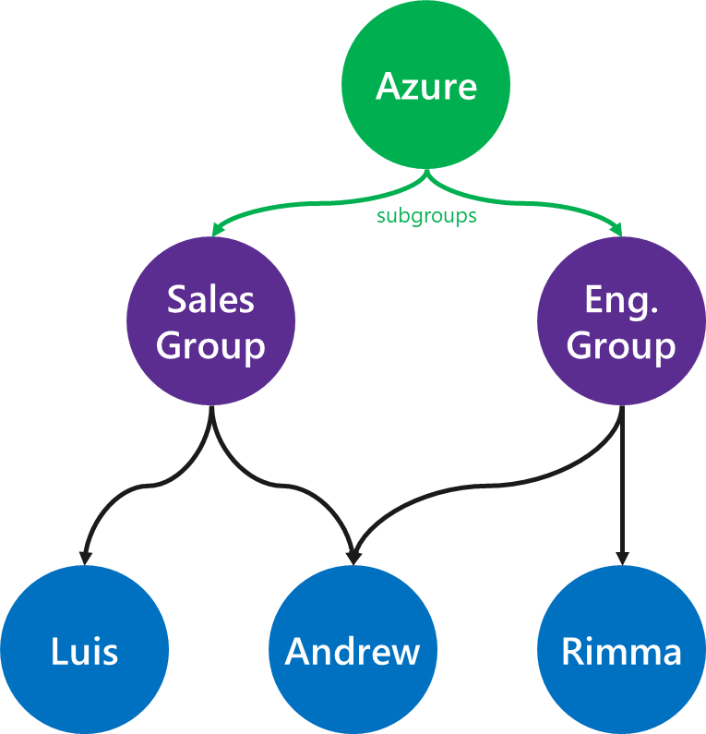
Nested groups Query comparison: get all groups under the Azure group
SELECT g.Group_ID, g.Group_Name FROM v3_Groups g
INNER JOIN v3_Group_Group gg
ON gg.FK_Child_Group_ID = Group_ID
WHERE FK_Parent_Group_ID =
(SELECT Group_ID FROM v3_Groups WHERE Group_Name='Azure')
g.V('Azure')
.out('subgroup')

Slide 24
Chapter 4: The overloaded workload

Slide 25
Additional hierarchies More than one hierarchical structure is represented in the database
Employee ID | Name
1 | Luis B.
2 | Rimma N.
3 | Andrew L.
FK Employee ID | FK Group ID
1 | 1
2 | 2
3 | 1
3 | 2
1 | 3
1 | 3
1 | 3
Azure
Group ID | Name
1 | Sales
2 | Engineering
3 | Azure
Sales
Group
Eng.
Group
FK Group ID | FK Nested Group ID
1 | 3
2 | 3
FK Employee ID | FK Report Employee ID
2 | 1
2 | 2
Luis
Andrew
Rimma
directReports
+ 1 table, 2 rows, 2 new columns
+ 2 documents

Slide 26

Additional hierarchies Query comparison: Obtain all managers from the Engineering Group
SELECT DISTINCT Employee_Name FROM v4_Employees e
INNER JOIN v4_Employee_Group eg
ON eg.FK_Employee_ID = e.Employee_ID
INNER JOIN v4_Employee_Employee ee
ON ee.FK_Parent_Employee_ID = e.Employee_ID
WHERE eg.FK_Group_ID = (
SELECT g.Group_ID FROM v4_Groups g
WHERE g.Group_Name = 'Engineering'
)
g.V('engineering')
.out('members')
.in('has_report')
.values('id')

Slide 27
Epilogue: The learnings

Slide 28
Cross-product complexity for relationship computation
FK Employee ID | FK Group ID
1 | 1
2 | 2
3 | 1
3 | 2
Employee ID | Name
1 | Luis B.
2 | Rimma N.
3 | Andrew L.
Group ID | Name
1 | Sales
2 | Engineering

Slide 29
Versioning challenges
v1
v2
v3
v4

Slide 30
Costly writes
Employee ID | Name
1 | Luis B.
2 | Rimma N.
3 | Andrew L.
4 | Hi
FK Employee ID | FK Group ID
1 | 1
2 | 2
3 | 1
3 | 2
1 | 3
1 | 3
1 | 3
4 | 2
4 | 3
Azure
Group ID | Name
1 | Sales
2 | Engineering
3 | Azure
Sales
Group
Eng.
Group
FK Group ID | FK Nested Group ID
1 | 3
2 | 3
FK Employee ID | FK Report Employee ID
2 | 1
2 | 2
2 | 4
Luis
Andrew
Rimma
Hi

Slide 31
Read query complexity
SELECT DISTINCT Employee_Name FROM v4_Employees e
INNER JOIN v4_Employee_Group eg
ON eg.FK_Employee_ID = e.Employee_ID
INNER JOIN v4_Employee_Employee ee
ON ee.FK_Parent_Employee_ID = e.Employee_ID
WHERE eg.FK_Group_ID = (
SELECT g.Group_ID FROM v4_Groups g
WHERE g.Group_Name = 'Engineering'
)
g.V('engineering')
.out('members')
.in('has_report')
.values('id')

Slide 32
Modeling principles
Graph databases provide benefits for hierarchical data and one-to-many entity relationships.
Property graphs allow for containing rich metadata in each entity object.
Labels allow for entity type detection and effective filtering.
Relationships have a direction that can be used meaningfully.

Slide 33
Filtering entities
An entity whose sole purpose is to serve as a filter to other entities.
Country vertex represents an abstract entity. Could have been derived from a table dimension.
This entity won't be updated, nor modified frequently.
The main use of this entity is to be used as a filter for the connected entities. This incurs in extra cost per query for all object resolution.
This will also increase the cost for inserting each related entity.
Country
Factory A
Factory B
g.V().has('countryId', X')
.outE('toFactory')
.inV('Factory')

Slide 34
Filtering entities
An entity whose sole purpose is to serve as a filter to other entities.
Country
Country vertex represents an abstract entity. Could have been derived from a table dimension.
This entity won't be updated, nor modified frequently.
The main use of this entity is to be used as a filter for the connected entities. This incurs in extra cost per query for all object resolution.
This will also increase the cost for writing each entity underneath it.
Factory A
Factory B

Slide 35
Filtering entities
An entity whose sole purpose is to serve as a filter to other entities.
The solution to this is to embed this dimension into the properties.
This simplifies the graph model and reduces the cost per query, which can now be served from the index.
Factory A
Factory B
g.V()
.has('Factory', 'countryId', 'X')
- country
- country

